Slide 1

Predicting Stock Price Trends Using Historical Data (AAPL)

Slide 2

Authors:
Varshini Sherapur Basavarajappa
Vinisha Purushotham Recharla
Dharanidhar Reddy Challa
Sai Nithin Krishna Souram

Slide 3

Background, Motivation, and Significance
This project refines stock prediction by adding advanced feature engineering (Bollinger bands, lagged features) and a sliding window for LSTM to improve performance over a simple nextday model.
Objective: Leverage machine learning (Linear Regression, Random Forest) and deep learning (LSTM) to predict Apple stock prices.
Key Challenge: Stock market volatility and complexity of price movements.

Slide 4

Research Questions
1. Does adding lagged features (past 5 days) and Bollinger Bands improve model accuracy?
2. Which model—Linear Regression, Random Forest, or LSTM—performs best?
3. How does a sliding window approach benefit LSTM for timeseries data?

Slide 5

Dataset Overview
Dataset: Apple Stock Prices (AAPL)
Source: Historical stock market data(Yahoo Website)
Number of Entries: 3,524
Key Variables: Date, Open, High, Low, Close, Volume
Target Variable: Next day's closing price
Missing values handled using forwardfilling.

Slide 6

Loading and Cleaning the Data
Data preprocessing steps:
Renamed columns for consistency
Converted date to datetime format
Handled missing values using forwardfilling
Sorted data by date

Slide 7
Handling Null Values and Outliers
• NULL VALUES : Missing data points that can affect analysis and predictions.
• Solution: Forward filling (fills missing values with the last available data).
• Alternatives: Interpolation, Mean/Median imputation.
• OUTLIERS: Extreme values that distort trends and model accuracy.
• Detection: Box Plot, Z-score, IQR.
• Handling: Capping extreme values, Log transformation.

Slide 8
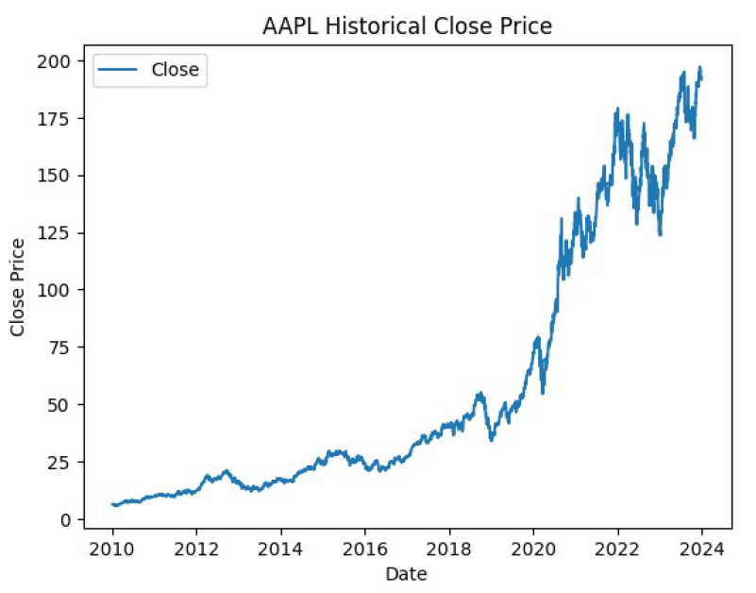
Exploratory Data Analysis

Slide 9
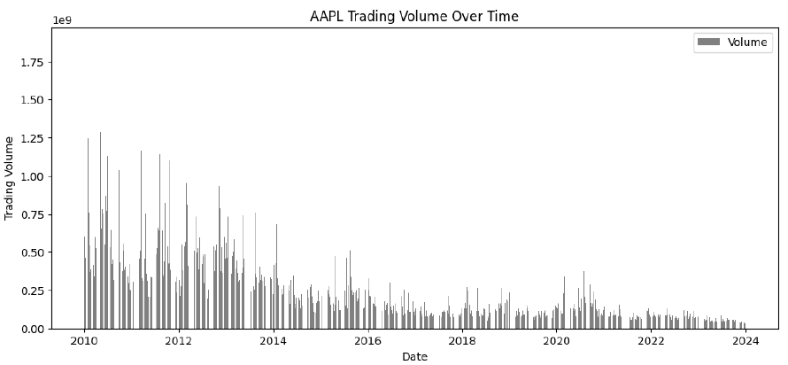
Trading Volume Over Time

Slide 10
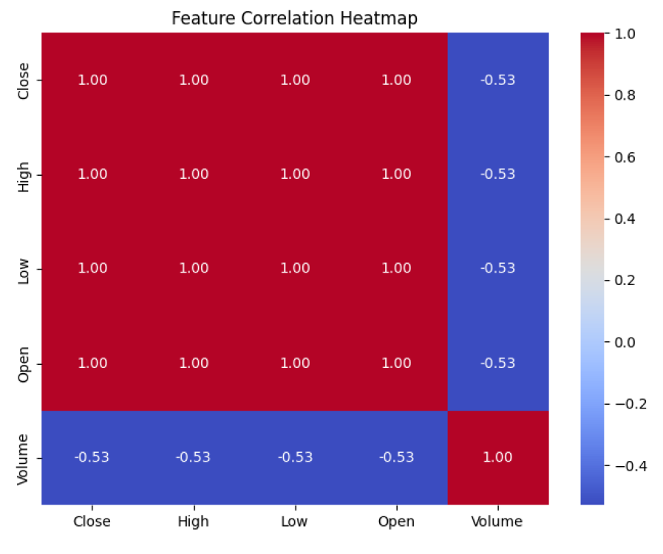
Feature Correlation

Slide 11
Advanced Feature Engineering
To improve predictive accuracy, the following features were engineered:
Bollinger Bands (Upper, Lower, Middle)
RSI (Relative Strength Index)
MACD (Moving Average Convergence Divergence)
30day Moving Average
Lag Features (Close prices from past 5 days)

Slide 12
Train/Test Split and Scaling
Data was split 80/20 chronologically, and features were scaled using MinMaxScaler.

Slide 13
Modeling Approaches
Linear Regression Baseline model using engineered features.
Random Forest Regressor Tuned with RandomizedSearchCV.
LSTM Neural Network Implemented with a sliding window approach.
Performance Metrics Used: RMSE, MAE, R² Score.

Slide 14
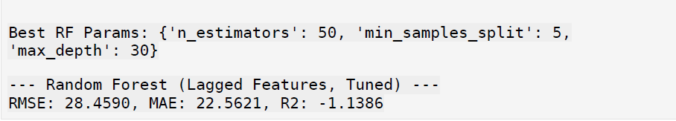
Linear Regression & Random Forest Tuning

Slide 15
LSTM with Sliding Window
Long Short-Term Memory (LSTM) neural networks effectively capture sequential dependencies, suitable for predicting Apple's stock prices using historical data.
Prepared data using 5-day sliding window sequences to maintain temporal accuracy.
Included technical indicators such as Open, High, Low, Close prices, Volume, Bollinger Bands, RSI, MACD, and Moving Averages.
Data normalization applied using MinMaxScaler for optimal training performance.

Slide 16
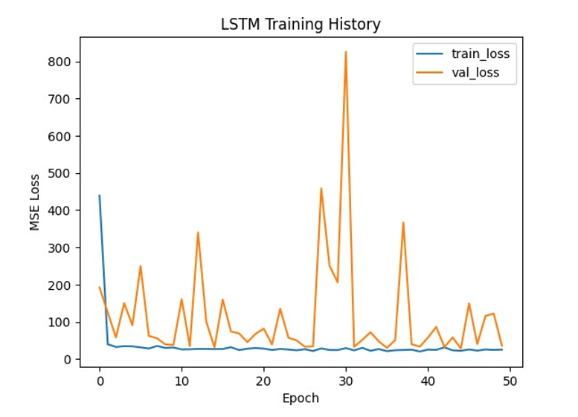
LSTM Model Architecture & Training
Model structure:
Two-layer LSTM (each with 64 neurons), Dropout layers (20%) for regularization.
Output layer predicts next-day closing price.
Chronological split for training (80%) and testing (20%).
Early stopping implemented to prevent overfitting (patience: 50 epochs).
Model trained using Adam optimizer and Mean Squared Error (MSE) loss function.

Slide 17
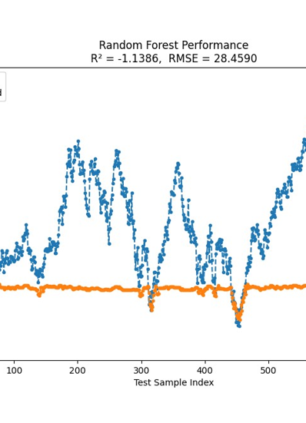
Model Performance & Metrics
Root Mean Squared Error (RMSE): 5.3071
Mean Absolute Error (MAE): 4.1859
R² Score: 0.9242, showing robust predictive performance.
Comparison:
Linear Regression (RMSE=2.7392, R²=0.9802) accurate but less adaptable.
Random Forest performed poorly (negative R²).
LSTM demonstrates a good balance between accuracy and adaptability.

Slide 18
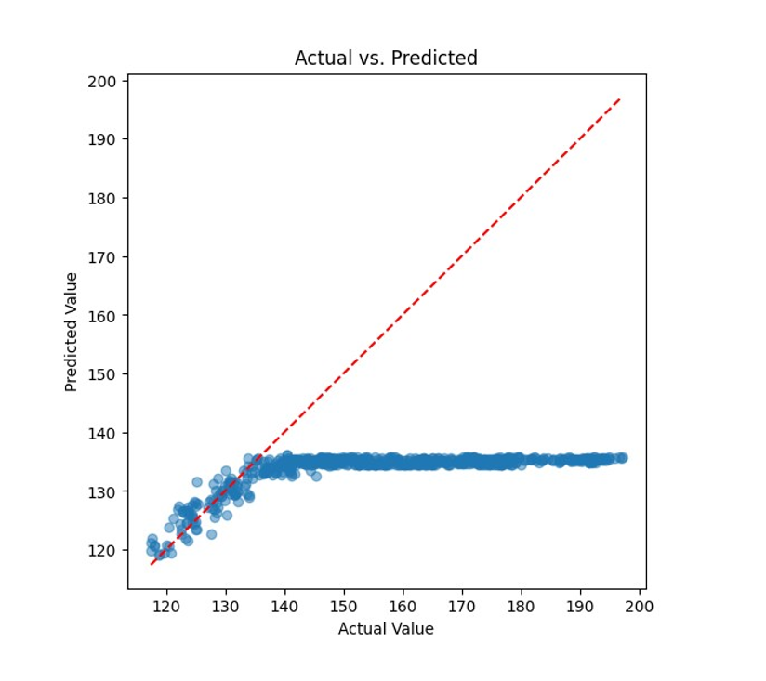
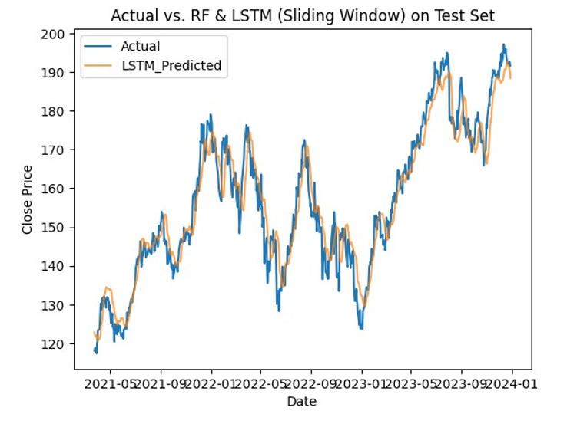

Slide 19
Challenges & Practical Implications
Limitations:
Difficulty during extreme volatility.
Computational intensity.
Recommendations:
Hyperparameter tuning, deeper networks, additional market indicators.
Practical use for investors in short-term forecasting, with caution during volatile periods.

Slide 20
Conclusion & Future Recommendations
Concluded effectiveness of LSTM with advanced features in stock price forecasting.
Suggested improvements:
Longer historical sequences.
Integration of additional financial indicators.
Exploration of more advanced neural network architectures for accuracy enhancement.

Slide 21
Model Performance – LSTM
Evaluation Metrics: RMSE: 0.1804
MAE: 0.1749
R² Score: 0.2257
Predicted Next-Day Close Price: $235.54 Actual Close Price (Previous Day): $220.84

Slide 22
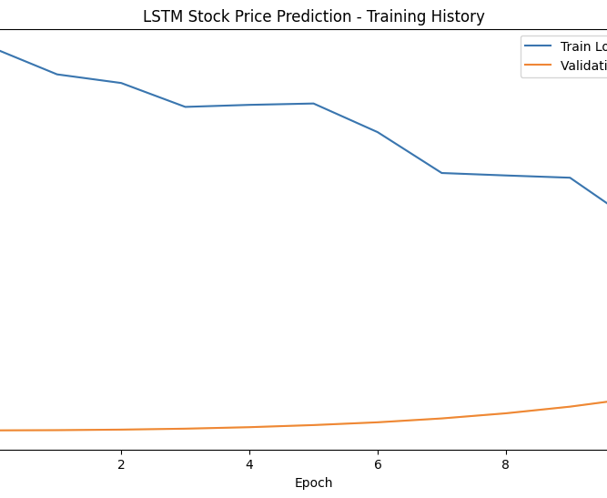
Back testing Approach/ Backtesting Results
Objective: Validate model predictions over multiple days Process: Use past 10 days of data
Predict the next day’s close price
Compare with actual values
Comparison of Predicted vs Actual Prices Observations: Model struggles with sudden market changes
Performs better in stable trends

Slide 23
Challenges & Limitations
Data Limitations: Dependent on historical trends
Sensitive to market volatility
Model Accuracy Issues: Random Forest less effective for stock prices
LSTM requires more training data
Potential Improvements: Hyperparameter tuning
Incorporating news sentiment analysis

Slide 24
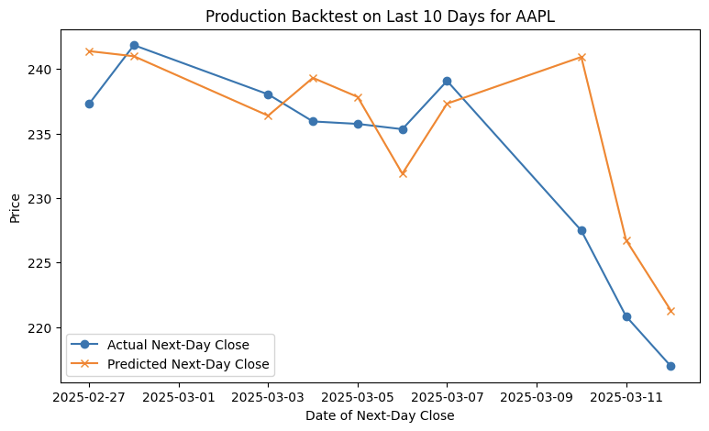

Slide 25
Conclusion & Future Work
Summary of Findings:
LSTM performs better for price prediction
Random Forest works for volume forecasting
Next Steps:
Improve model accuracy
Explore alternative models like Transformer-based architectures

Slide 26

Thank You

